Slide 1
MACHINE LEARNING CLASSIFICATION PROJECT
AYESHA IMRAN
2023-BS-AI-061
BSAI-4A

Slide 2
PROJECT INTRODUCTION
Title: Personality Prediction – Extrovert vs. Introvert
Goal: To classify individuals as Extrovert, Introvert, or Ambivert using machine learning.
Why it matters? Personality prediction is useful in HR, psychology, education, and recommendation systems.

Slide 3
DATASET: Personality Behavior Dataset
Target Variable: Personality Type Classes:
0 = Introvert
1 = Extrovert
2 = Ambivert
Features Include:
Gender,Age,Sleep schedule,Talking frequency,Group activity involvement
Internet/social media use
Hobbies, alone-time preference, etc.

Slide 4
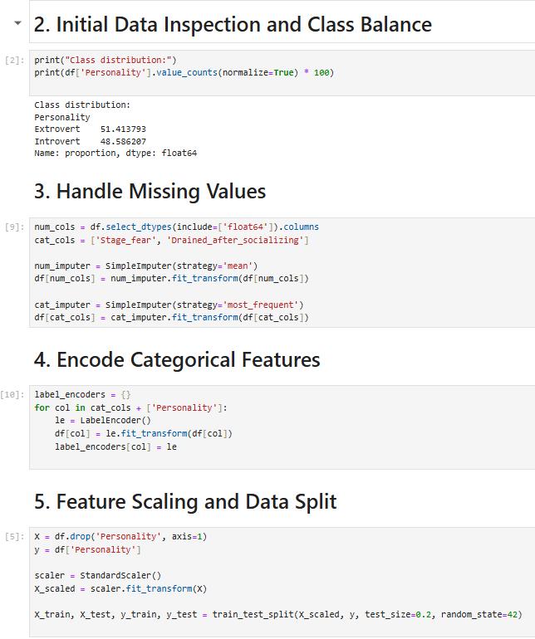
PREPROCESSING STEPS
Missing Values:
Handled using mode (categorical) and mean (numerical)
Label Encoding:
Gender and Personality Type converted to numeric
Scaling:
Used StandardScaler for numerical values
Train-Test Split:
80% for training, 20% for testing

Slide 5
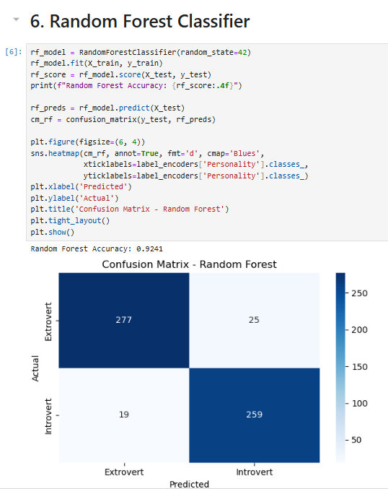
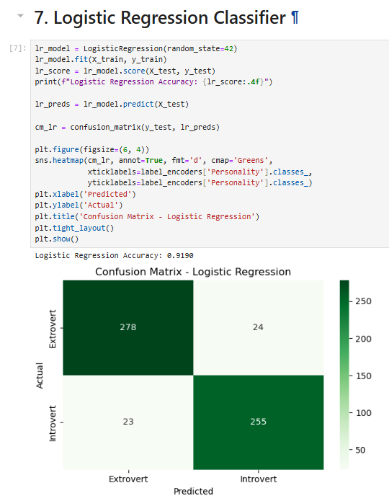
MODELING
ML Models Used:
Logistic Regression
Simple baseline model
Easy to interpret
Random Forest Classifier
Ensemble of decision trees
Handles nonlinearity well

Slide 6
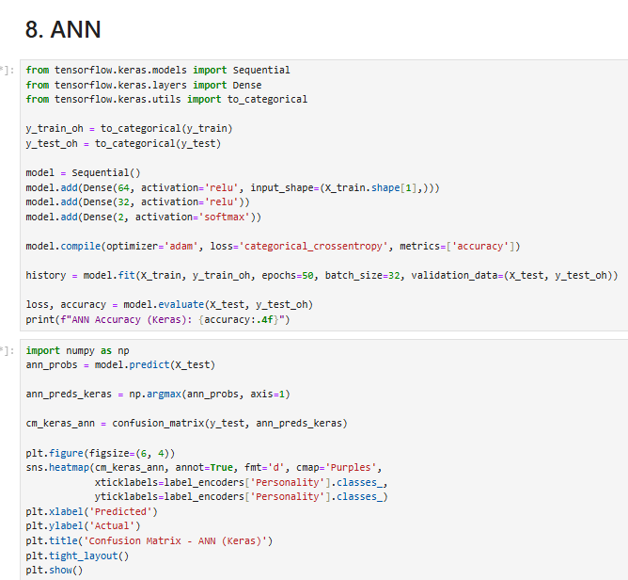
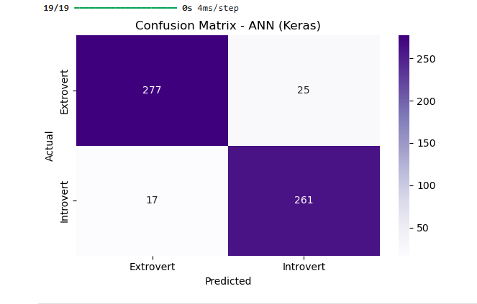
MODELING
Artificial Neural Network (ANN)
Built using TensorFlow/Keras
Architecture:
Input Layer
Hidden Layers (ReLU activation)
Output Layer (Softmax)

Slide 7
EVALUATION
Metrics Used:
Accuracy
Precision
Recall
F1-Score
Confusion Matrix
(For ANN) Validation Accuracy/Loss Curves
Results Comparison:
Model | Accuracy
Logistic Regression | ~78%
Random Forest | ~85%
ANN | ~89% ✅

Slide 8
KEY FINDINGS
Top Predictors:
Talk time
Social habits
Activity preferences
Model Comparison:
ANN outperformed others due to better pattern recognition
Logistic Regression was less flexible with complex patterns
Random Forest was good but not as deep as ANN

Slide 9
CONCLUSION
Built and evaluated 3 classification models
ANN provided the best performance
Pipeline includes real-world challenges like missing data, scaling, encoding
Applicable in personality-based recommendation systems
“With data and deep learning, we’re not just modeling numbers — we’re decoding personalities.”

